Slide 1
Be A Prudent Investor
Basics of Stock Selection through Fundamental Analysis

Slide 2
Indian Securities Market - Overview
Market Regulator SEBI
Stocks and Commodities Derivative Exchanges
Depositories
Other Intermediaries
NSE, BSE, MSE, MCX etc.
NSDL, CDSL
Stock Brokers, RTAs, Mutual Funds, Investment Advisors etc.

Slide 3

Why Do We Invest?
Investment is necessary to support your financial needs when you do not earn money.
By investing a portion of your income you allow money to grow and work for you.
3 parameters to assess suitability of any investment avenue are –
Return potential
Safety
Liquidity
Various avenues where money can be invested, are broadly classified into some groups, known as ‘Asset Class’. Stocks or Equity shares are most popular class of assets.

Slide 4

What is meant by Stock Selection?
Stock selection is the selection of one or more stock (or shares) based on certain set of criteria in order to maximise the probability of meeting the trading or investment objective.
There are more than 5000 stocks available for trading or investment. None can trade or invest in all at the same time.
Hence, one needs to select a manageable number of stocks.
Fundamental and Technical Analysis are the two most preferred tools for stock selection.

Slide 5
Types of Analysis
Fundamental
Analysis
Technical
Analysis

Slide 6

Fundamental Analysis
Fundamental analysis is a method used to identify the true value of a stock.
The current price of a stock may not reflect the actual value of the stock. The stock may be overvalued or undervalued in the market.
Fundamental analysis helps investors to study the health of the company, and thus leading to the actual value of the stock.
This is done by using various qualitative and quantitative factors.
The main purpose of this method is to identify companies that that are fundamentally strong in order to invest in them for the long term.

Slide 7
Fundamental Analysis
Fundamental Analysis
Fundamental analysis (FA) is a long-run analysis.
Fundamental Analysis is a method of measuring the intrinsic value of a security by examining the economic and financial factors.
Fundamental analysts study the factors that can affect the security's value, from macroeconomic factors such as the state of the economy and industry conditions to microeconomic factors like the effectiveness of the company's management.
The end goal is to arrive at a number that an investor can compare with a security's current price in order to see whether the security is undervalued or overvalued.
Strategy is-
Buy- when the security is undervalued
Sell- when the security is overvalued

Slide 8
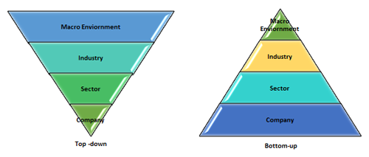
Approaches to Fundamental Analysis
E - Economic Analysis
I - Industry Analysis
C - Company Analysis

Slide 9
Economic Analysis
Economic analysis is the process of analyzing the whole economy and the factors affecting it.
Economic analysis overlooks all the economic conditions and economic activities which affect the profit of the company.
It helps in determining whether the factors have a favorable or unfavorable impact on the economy.
This allows investors to analyze the market from the big picture all the way down to individual stocks.
By examining the economic numbers one can determine the current market strength and have a better idea of what the future holds.
Expectation of a booming economy can lead to an increase in company profit and security prices will rise due to buying pressure.

Slide 10

Economic Analysis
Key Economic indicators investors must incorporate while selecting stocks:
GDP of a nation
Interest rate
Fiscal policy
Monetary policy
Business cycle
Exchange rate
Indices (e.g. Nifty, Sensex)
Gross Domestic Product (GDP)
Unemployment rate
Inflation rate
Consumer Confidence
Purchase Managers' Index

Slide 11

Industry Analysis
Industry may be defined as a homogeneous group of firms providing a similar type of goods or services.
For example- The auto-mobile industry, IT industry, FMCG industry, etc.
Since the economic conditions and policies do not affect all the industries equally it becomes necessary to analyze every industry.
For example- Food and spices industry is less affected by business-cycle, whereas luxury products are highly volatile to business-cycle.
Key factors of Industry analysis-
Past performance of the industry
The performance of the product and the technology
Role of government
Labor conditions
Competitive conditions
Industry life cycle

Slide 12
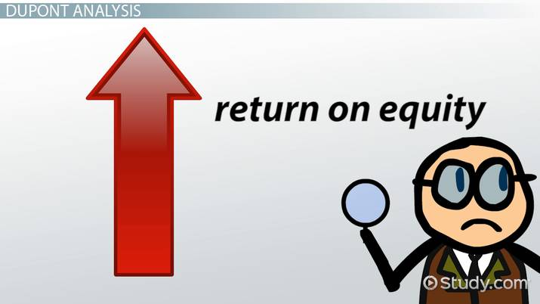
Company Analysis
Company analysis deals with the performance of the company.
The basic objective of company analysis is to identify specific companies or specific shares which are expected to perform well in the future.
Information is needed for company analysis.
Information may be:
Qualitative
Quantitative

Slide 13
Company Analysis
Management of the Company-
Questions like how efficient the management is, who are the key personnel officers, the working of the management, etc. can help in finding out a suitable company.
Corporate Governance-
How is the governance of the company, how the BOD is doing, how much is the transparency, how the duties and responsibilities have been assigned etc.?
Competitive advantage-
what competitive advantage does the company is having over other companies?
Business model-
what is the business model of the company i.e. source of revenue of the company
Qualitative Factors of Company Analysis are:-
Management of the company
Corporate governance
Competitive advantage
Business Model

Slide 14

Company Analysis
Qualitative Analysis
It takes into account information that can not be expressed in numbers.
It relates to the company itself.
Factors – examples –
Management experience and performance
Corporate governance
Industry and competition etc.

Slide 15
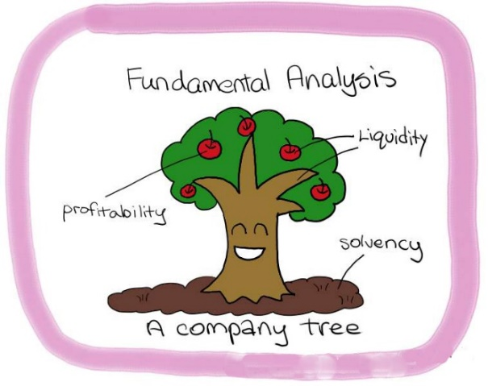
Company Analysis
Analyzing the company’s earnings through:
Financial Statement Analysis
Cash Flow Analysis
Fund flow analysis
Comparative statement
Common size statement
Ratio Analysis
Profitability Ratio
Liquidity ratio
Activity Ratio
Solvency Ratio
Equity Valuation Model
Quantitative Factors of Company Analysis
Sources are the following:-
Balance sheet
Profit and loss account
Cash flow statement
Notes to accounts

Slide 16

Company Analysis
Quantitative Analysis
It is related to information that is shown in company’s financial statements. It involves measuring simple statistical data to complex calculations.
This analysis helps you to evaluate investment opportunities such as when to buy and sell securities.
Factors – examples -
Company’s revenues
Profit margins
Return on equity
Future growth potential
Financial ratios

Slide 17
Using Financial Ratios for Fundamental Analysis
1. Price To Earnings Ratio
It is one of the most widely used financial ratio analysis.
Computation - Price Per Share / Earnings Per Share.
As a thumb rule, a low P/E ratio is preferred while buying a stock.
2. Price To Book Value
Computation - Current price of the stock / Book value per share.
A lower P/BV ratio could mean that the stock is undervalued.
However, the definition of lower varies from sector to sector.

Slide 18
Financial Ratios
3. Return On Equity (ROE)
It is the amount of net income returned as a percentage of shareholders equity.
Computation - Return on Equity (Net Income) / Average Stockholder Equity.
4. Debt To Equity Ratio
It measures the relationship between the borrowed capital (i.e. debt) and the capital contributed by shareholders (i.e. equity).
Computation - Total Liabilities / Total Shareholder Equity.
As a thumb of rule, companies with a debt-to equity ratio more than 1 are riskier.

Slide 19
Financial Ratios
5. Current Ratio
It is a key financial ratio for evaluating a company's liquidity.
Computation - Current Assets / Current Liabilities.
As a thumb rule, a company with a current ratio greater than 1 is better.

Slide 20
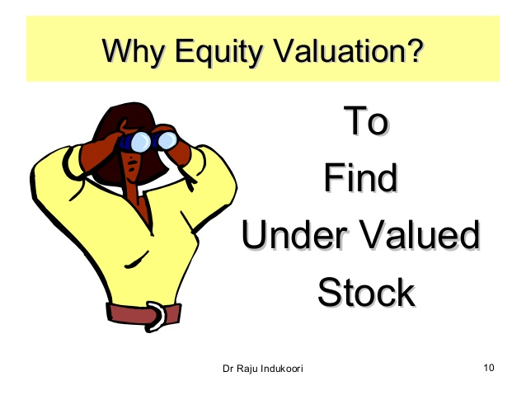

Slide 21
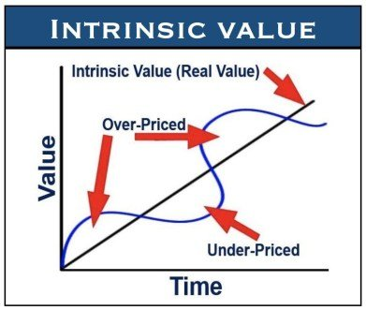
Equity Valuation Model
Equity valuation helps in determining the true, intrinsic, or fair value of the share of the company.
Equity valuation is important for every investor as it prescribes whether to buy the security or sell the security or stay invested.
The strategy here is –
Buy- when the intrinsic value > Market value and,
Sell- when the intrinsic value < Market Value

Slide 22

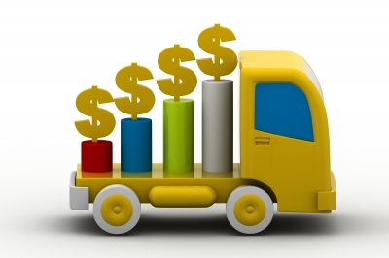
Equity Valuation Model
Dividend Discount Model
Constant Dividend Model
Constant Growth Model
Multi Stage Growth Model

Slide 23
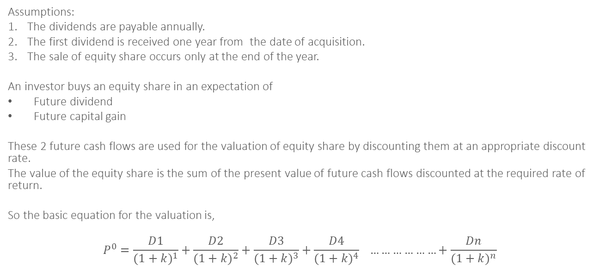
Dividend Discount Model
Assumptions:
The dividends are payable annually.
The first dividend is received one year from the date of acquisition.
The sale of equity share occurs only at the end of the year.
An investor buys an equity share in an expectation of
Future dividend
Future capital gain
These 2 future cash flows are used for the valuation of equity share by discounting them at an appropriate discount rate.
The value of the equity share is the sum of the present value of future cash flows discounted at the required rate of return.
So the basic equation for the valuation is,
$$P^{0}=\frac{D1}{{(1+k)}^{1}}+\frac{D2}{{(1+k)}^{2}}+\frac{D3}{{(1+k)}^{3}}+\frac{D4}{{(1+k)}^{4}} ………………+\frac{Dn}{{(1+k)}^{n}}$$

Slide 24
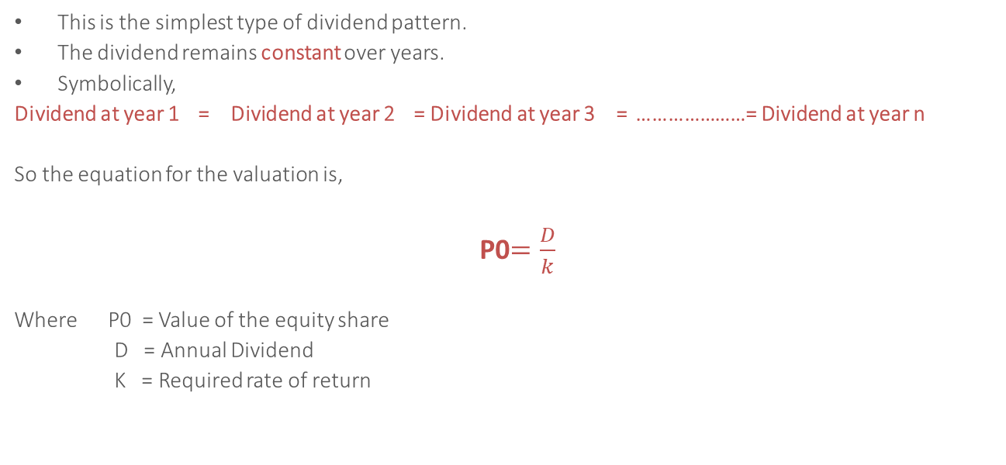
Constant Dividend Model
This is the simplest type of dividend pattern.
The dividend remains constant over years.
Symbolically,
Dividend at year 1 = Dividend at year 2 = Dividend at year 3 = …………………= Dividend at year n
So the equation for the valuation is,
P0$=\frac{D}{k}$
Where P0 = Value of the equity share
D = Annual Dividend
K = Required rate of return

Slide 25
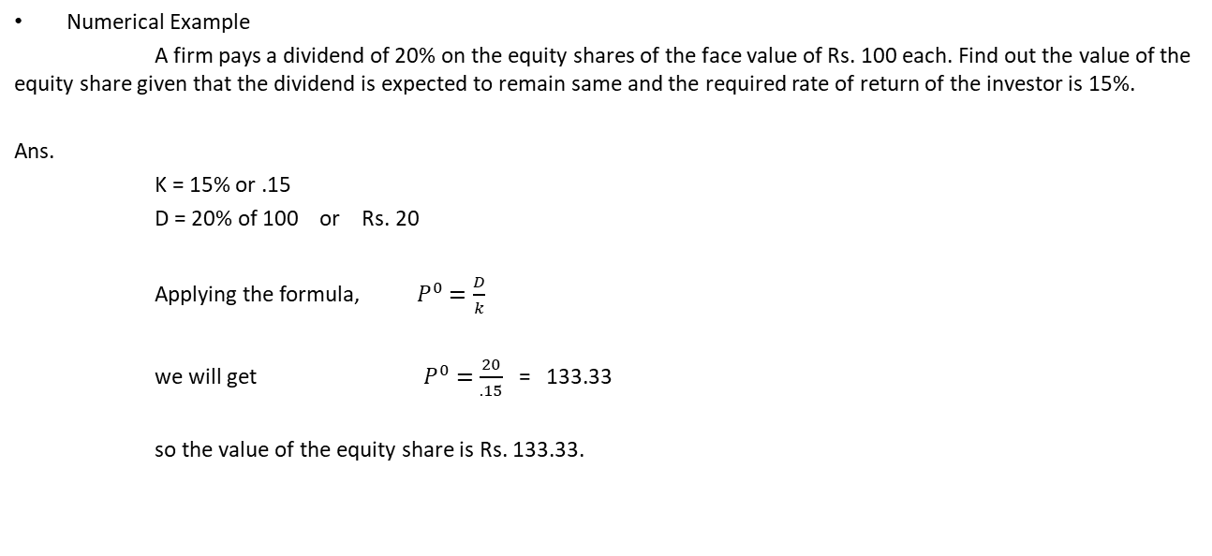
Constant Dividend Model
Numerical Example
A firm pays a dividend of 20% on the equity shares of the face value of Rs. 100 each. Find out the value of the equity share given that the dividend is expected to remain same and the required rate of return of the investor is 15%.
Ans.
K = 15% or .15
D = 20% of 100 or Rs. 20
Applying the formula,$P^{0}=\frac{D}{k}$
we will get $P^{0}=\frac{20}{.15}$= 133.33
so the value of the equity share is Rs. 133.33.

Slide 26
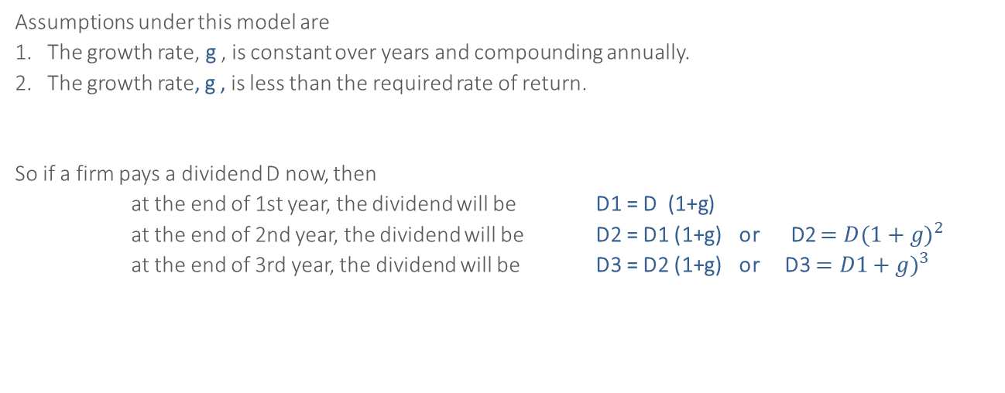
Constant Growth in Dividend Model
Assumptions under this model are
The growth rate, g , is constant over years and compounding annually.
The growth rate, g , is less than the required rate of return.
So if a firm pays a dividend D now, then
at the end of 1st year, the dividend will be D1 = D (1+g)
at the end of 2nd year, the dividend will be D2 = D1 (1+g) or D2 $={D(1+g)}^{2}$
at the end of 3rd year, the dividend will be D3 = D2 (1+g) or D3 $={D1+g)}^{3}$

Slide 27
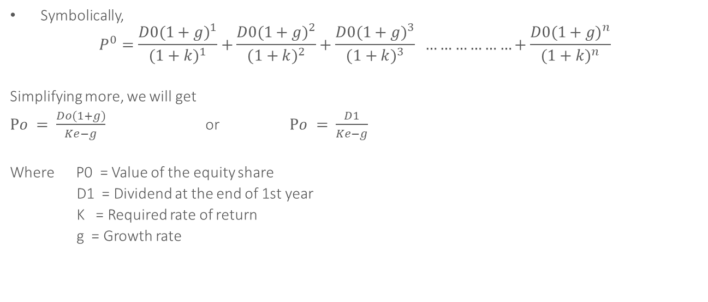
Constant Growth in Dividend Model
Symbolically,
$$P^{0}=\frac{{D0(1+g)}^{1}}{{(1+k)}^{1}}+\frac{{D0(1+g)}^{2}}{{(1+k)}^{2}}+\frac{{D0(1+g)}^{3}}{{(1+k)}^{3}} ………………+\frac{{D0(1+g)}^{n}}{{(1+k)}^{n}}$$
Simplifying more, we will get
$Po = \frac{Do(1+g)}{Ke−g}$ or $Po = \frac{D1}{Ke−g}$
Where P0 = Value of the equity share
D1 = Dividend at the end of 1st year
K = Required rate of return
g = Growth rate

Slide 28

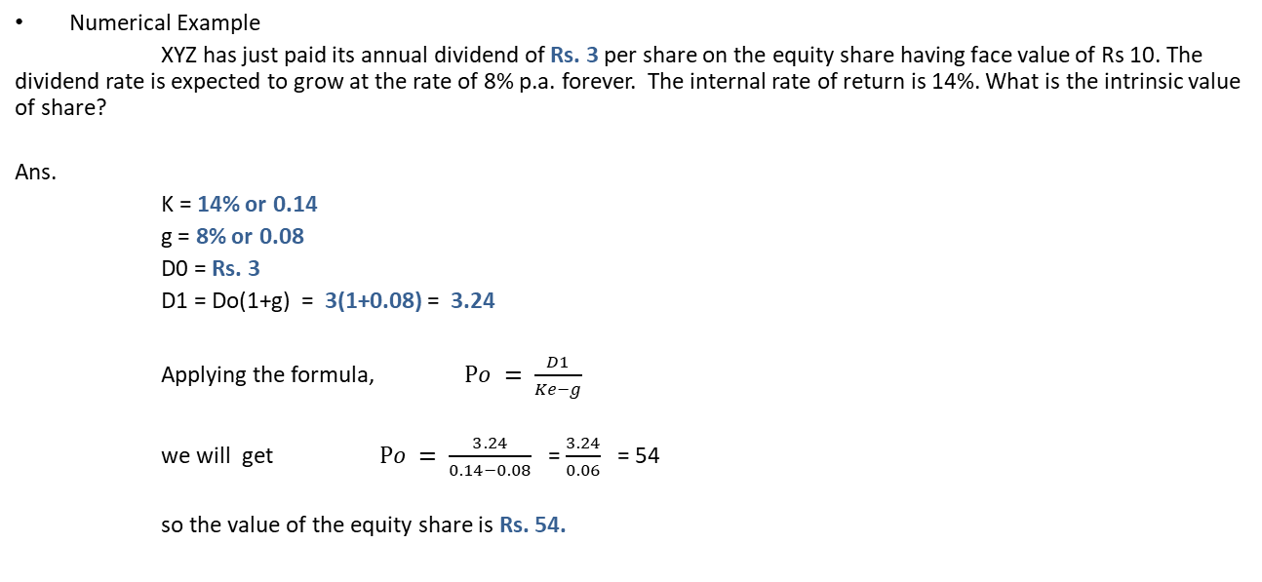
Constant Dividend Model
Numerical Example
XYZ has just paid its annual dividend of Rs. 3 per share on the equity share having face value of Rs 10. The dividend rate is expected to grow at the rate of 8% p.a. forever. The internal rate of return is 14%. What is the intrinsic value of share?
Ans.
K = 14% or 0.14
g = 8% or 0.08
D0 = Rs. 3
D1 = Do(1+g) = 3(1+0.08) = 3.24
Applying the formula, $Po = \frac{D1}{Ke−g}$
we will get $Po = \frac{3.24}{0.14−0.08}$ = $\frac{3.24}{0.06}$ = 54
so the value of the equity share is Rs. 54.

Slide 29

Multi-Stage Growth Rate Model
This model is also known as variable growth in dividend.
This is the most realistic model as it has more than one growth rate.
For example, for first five years the growth in dividend may be 2%, then it may be 3% for next three years and finally 5% infinitely.

Slide 30
Multi Stage Growth Rate Model
Question- A firm is paying a dividend of Rs 1.50 per share. The rate of dividend is expected to grow at 10% for the next 3 years and then 5% infinitely. Find out the value of the share given that the required rate of return for investors is 15%.
Solution:-
K= 15%, D= 1.50, g1= 10%, g2= 5%
Calculate the value of cash dividend at the end of each year
Rs. 4.14 is the present value of the expected dividend for the first 3 years.
End of year(n) | Dividend amount | PVF (15%,n) | Present value
1 | 1.65 (1.5+10%) | .870 | 1.44
2 | 1.82 (1.65+10%) | .765 | 1.38
3 | 2.00 (1.82+10%) | .658 | 1.32
Total |  |  | 4.14

Slide 31

Multi Stage Growth Rate Model
Rs. 4.14 is the present value of the expected dividend for the first 3 years.
After the end of the 3rd year the growth rate is 5%.
The value of equity share at the end of 3rd year will be
P3 $= \frac{D3(1+g)}{(ke−g)}$ = $\frac{2(1+.05)}{(15−.05)}$ = 21
The value of the share at the end of year 3 will be 21. The present value of share of Rs. 21 is
The value of the share at the present is
4.14 + 13.82 = 17.96
Rs. 21 * PVF(15%,3)
= 21* 0.658
= 13.82

Slide 32
THANK YOU

